Slide 1
Rocket Activity
Project X-51

Slide 2
Purpose
The United Space Authority is seeking competitive bids for an advanced rocket capable of launching large amounts of rocket fuel into Earth’s orbit at low cost.
The winning company will design and test a rocket capable of transporting fuel to space at the best cost.
Using STEM skills you will develop a budget, purchase construction materials, and track expenditures while designing and constructing a rocket.
You will keep a rocket journal in a folder that details the rocket design and construction process.

Slide 3
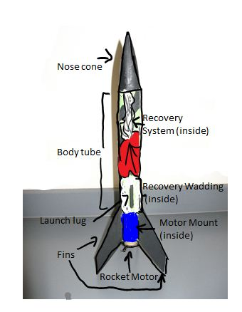
What does it take to build a rocket?
--body tube
--nose cone
--fins
--adhesive
--fuel
--launch port
--decoration?
--weight?
--string (for string test)
--silhouette panel
--items to increase rocket performance?
--Nasa consultation?
--Penalty slips?

Slide 4
Day 1
Badges p124—Choose officers and fill out badges. Staple badges to your project folder
Budget p126—These are the items available for purchase. You have a budget of $1,000,000. What items are you going to need?
Budget projection p128 list the items you are planning on purchasing.
On a sheet of copy paper sketch a preliminary rocket design.

Slide 5
Day 2
Checks and purchase orders p127
To order materials you will need to fill out a purchase order the day BEFORE you expect to use the item. P.O’s must be filled out correctly and completely before the order will be filled.
To pay for materials a check that matches the purchase order must be written. The check requires two signatures and should then be attached to the P.O. and submitted to the teacher.
Each expense should be recorded on the Balance Sheet p. 130
Check stubs should be attached to a sheet of copy paper and kept in you project folder

Slide 6
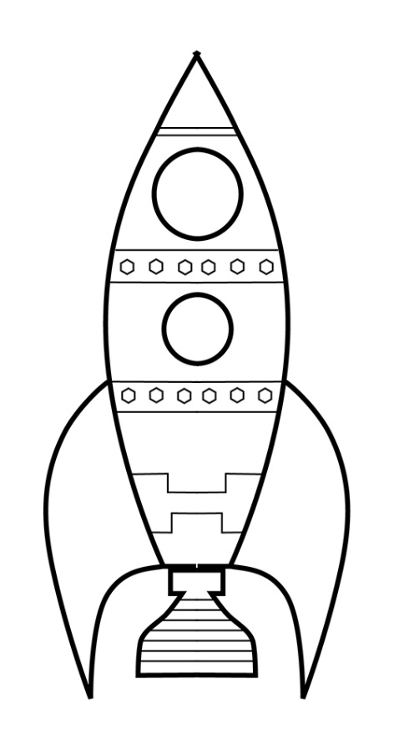
Day 2 continued
Order any materials needed to begin rocket construction tomorrow
Complete Certificate of Assumed Name and submit to teacher.
Do scale drawing p132. Note that each square is = to 2 centimeters.

Slide 7
Days 3-5
Construction of rockets. Make sure to place orders each day for items you wish to use the next day.
Continue to record expenses on balance sheet and keep track of check stubs.

Slide 8
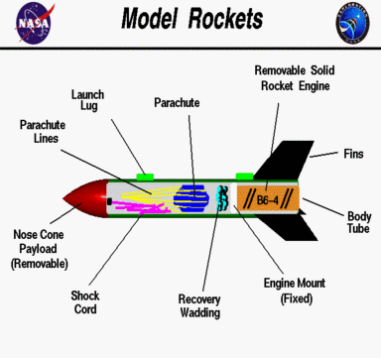
Day 6
Finish construction.
Find center of mass and pressure p133-134.

Slide 9
Day 7
Make a silhouette of your rocket p. 134 #3
Complete Rock analysis p. 135

Slide 10
Day 8
Do a swing test.
Finish any other remaining work.
Organize and complete rocket folder

Slide 11
Day 10
Fill out flight day log p136.
Launch Day!!!!!

